Slide 1
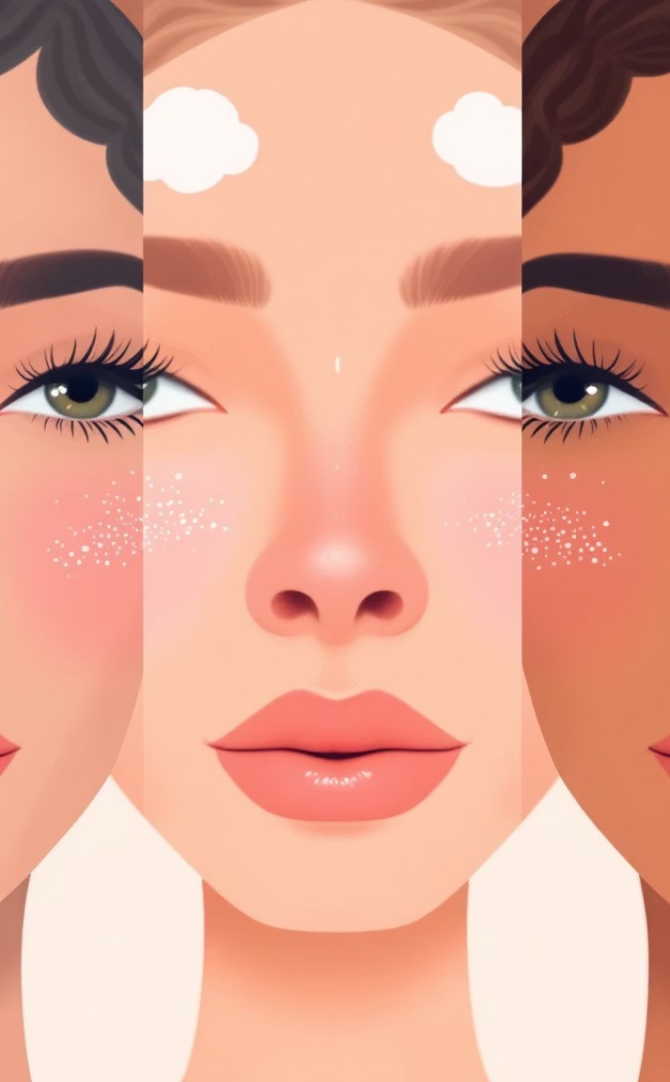

GlowAI - AUtom6ted BlemiSh Detection & Cl6SSific6tion
Why It'S ImpoTt6nt
Skin conditions appear similar to non-experts
Prevents incorrect self- treatment
Facilitates early intervention
Why It'S Ch6llenging
Subtle color and texture differences
Variable lighting and angles Skin tone diversity
Multiple blemishes per face
CUTTent SolUtionS
Manual dermatology inspection Low-accuracy mobile applications
No reliable ML for segmentation + classification

Slide 2

PToject T6Sk DeScTiption
Developing a robust two-stage pipeline for precise blemish analysis.
The PToblem:
Given a selfie image, detect all facial blemish regions and classify each into one of six predefined skin-condition classes
Acne 3 pimples, inflamed bumps
Redness 3 irritation or localized inflammation Hyperpigmentation 3 dark spots / discoloration Dryness 3 dry or flaky skin
Texture Issues 3 uneven skin texture / enlarged pores
Scarring 3 post-acne scars or indentations
InpUt
RGB selfie image
OUtpUt
Binary mask (blemish=1, normal skin=0) Extracted blemish regions
Class label (6 classes)
Facial location (forehead, cheeks, chin, nose) Short explanation + skincare suggestion
Novelty
Two-stage pipeline (mask ³ region classification) Region-level predictions
Synthetic data for balanced training

Slide 3
ModelS & MethodS
A cascaded approach integrating segmentation and classification for enhanced accuracy.
1
Selfie InpUt
2
Bin6Ty M6Sk Model
(Segmentation)
2
Region ExtT6ction
Ł
Cl6SSific6tion Model
(EfficientNet, 6 classes)
5
F6ce Loc6tion
6
Recommend6tion
Segment6tion Model
Generates the initial binary mask.
EfficientNet Cl6SSifieT
Specialized for 6 distinct skin condition classes.
Fine-tuning and adjustments:
Adaptive threshold tuning Extensive data augmentation
Hybrid training: synthetic + real data Validation exclusively on real-world data

Slide 4
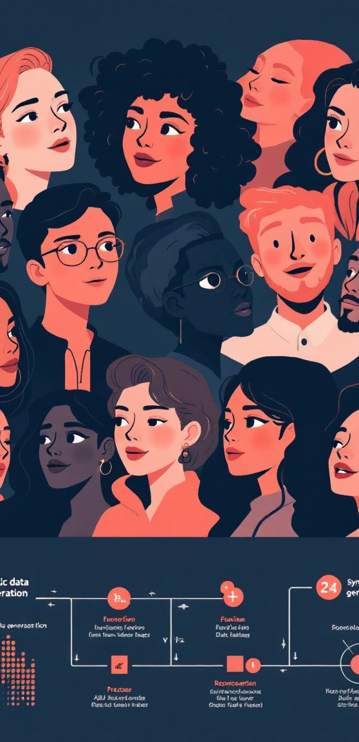

D6t6 Specific6tion & GeneT6tion
Constructing a robust dataset through real-world collection and synthetic expansion.
Re61 Seed D6t6
~20 clean faces per class. Provides foundational real-world examples for model training.
Synthetic D6t6
~1000 samples per class. Generated via inpainting and full- image generation to ensure class balance and diversity.
Re61 Ev61U6tion Set
100% real images, meticulously annotated with masks and class labels. Used for unbiased performance assessment.
Dataset Requirements:
Balanced class distribution
High variation in lighting, skin tone, angle, and severity

Slide 5
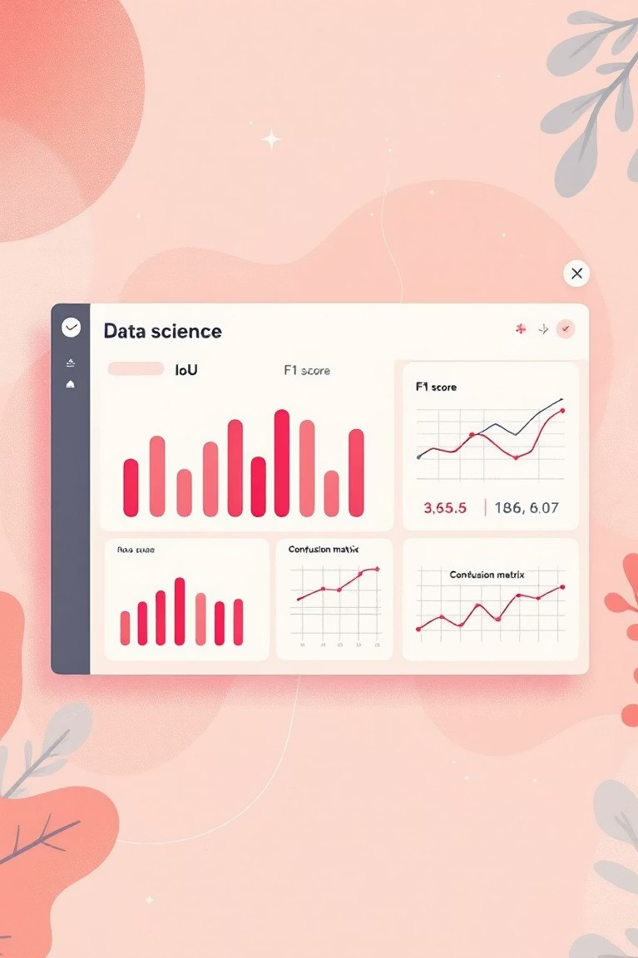
Metrics & KPIs
Rigorous evaluation to ensure model efficacy and reliability.
Detection Metrics
Intersection over Union (IoU) Dice Score
Pixel Accuracy
Classification Metrics
Accuracy
Precision / Recall / F1-Score Confusion Matrix analysis
End-to-End Metrics
Correct detection + correct classification per region
Percentage of blemishes correctly identified per face
Evaluation Protocol
80/20 Train/Validation Split
Testing exclusively on real images
Ground truth: manually annotated masks and labels

